Slide 1



Basic Details of the Team and Problem Statement
PSID: KBH-001
Title of PS: New age women safety app
Team Name: Gang Beta
Team Leader Name: Arnab Paul
Institute Code (AISHE): 1-3392703851
Institute Name: Techno India University, West Bengal.
1.

Slide 2


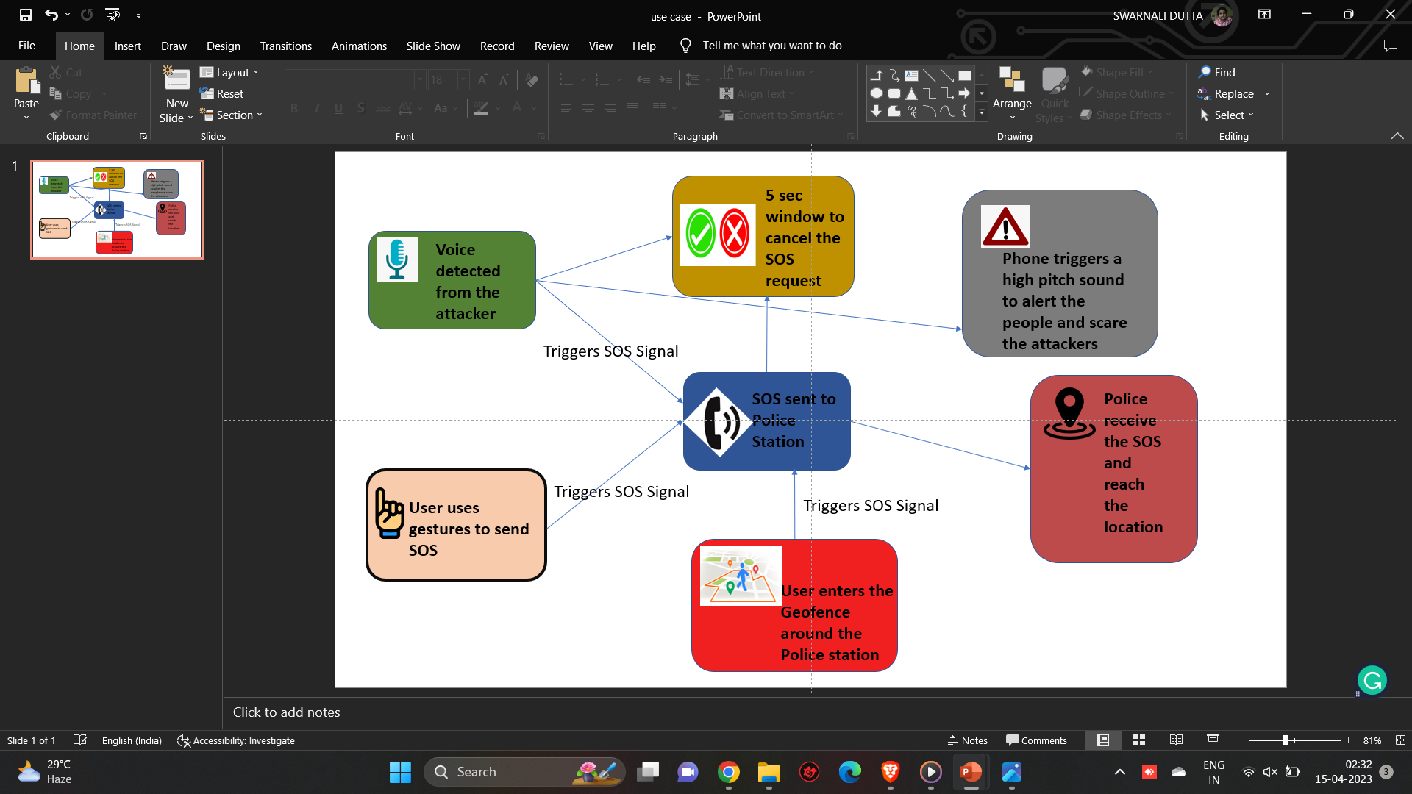
Approach Details
Use Cases (Diag. Representation)

Slide 3


Idea /Approach Details
The aim of this project is to aid women in need of help in case of danger like assault, theft etc.
The app will send automated SOS signal to the numbers that the user wants to send, also the helpline numbers (The Police) and get help from the nearest police station.
Problem Statement:
To design an app for the safety of new-age women.
It can automatically send SOS signals when it detects some kind of sound/scream.
It can also show the user locations of nearby police stations and give a message prompt when the user is at a certain distance away from the stations.
Approach:
We will develop an android/iOS app using flutter
ML will be used to distinguish and recognize speech for the automated SOS signal.
Google Maps API will be used to show the user the nearby location of Police Stations.
Geofencing will be used to alert the user when they reach near a Police Station.

Slide 4
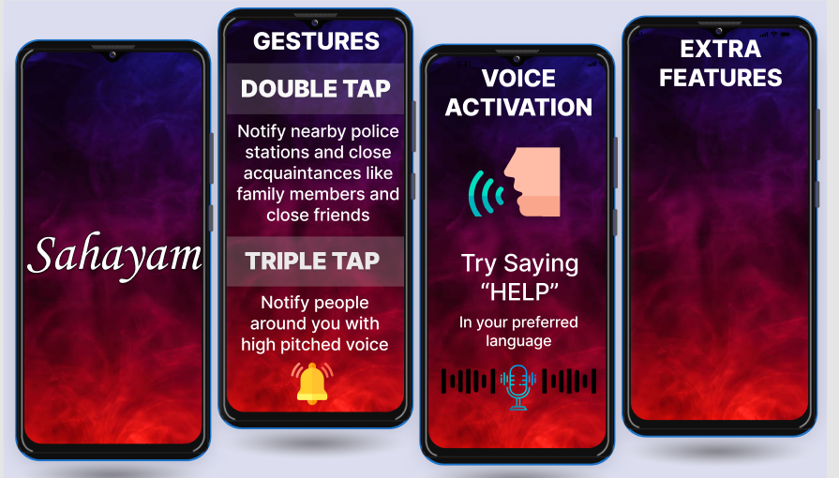

We can use our app’s API with smart watches, bands and other accessories like bracelets, pins etc. in the form of a chipset.
Notes:
We can use our apps API with smart watches, band and other accessories like bracelets etc etc.

Slide 5


Team Member Details
Sr. No. | Name of Team Member | Branch (Btech/Mtech/PhD etc): | Stream (ECE, CSE etc): | Year | Position in team (Team Leader, Front end Developer, Back end Developer, Full Stack, Data base management etc.)
1 | Arnab Paul | BTech | CSBS | Third | Team Leader
2 | Sohom Neogi | BTech | CSE | Third | Full Stack
3 | Sumedha Chakraborty | BTech | CSE | Third | UI/UX Design
4 | Swarnali Dutta | BTech | CSE | Third | Front end
5 | Rohan Mondal | BTech | CSE | Third | Back end
6 | Sattik Ghosh | BTech | CSE | Third | Data Resourcing
s.no | Name of Mentor | Category (Academic/Industry): | Department
1. | Dr. Anindya Kumar Biswas | Mentor | CSE
2. | Prof Ratul Dey | Mentor | CSE

